Slide 1


Smart Irrigation System
Stefano Sacchet
Matteo Mascherin Lorenzo Dongili
Embedded Software for the Internet of Things project

Slide 2
Problem Statement
What the project aim at?
Automatic offline irrigation system
Real time data from sensors
Internet of Things expansion to store data in a database
Telegram Bot to have an online and wireless control on the system

Slide 3
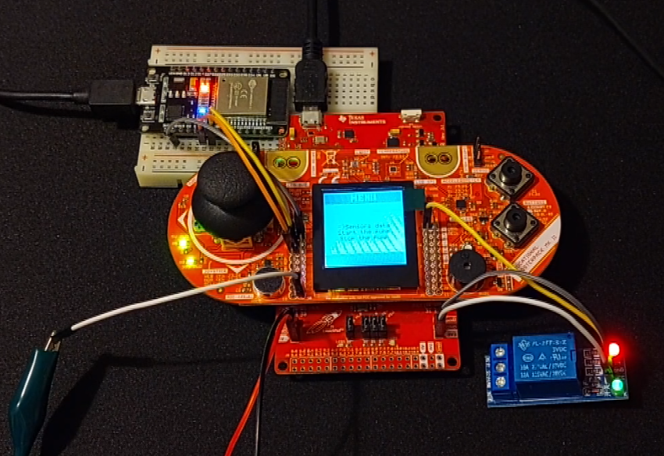
Working Scheme
User interaction:
Offline, using Boosterpack controller
Remotely, using Telegram bot
Automatic mode: the user lets the system working autonomously based on sensor values.
Hardware used:
MSP432 + Boosterpack-EDUMMKll
ESP32
Moisture, Light and temperature sensors
Relay

Slide 4
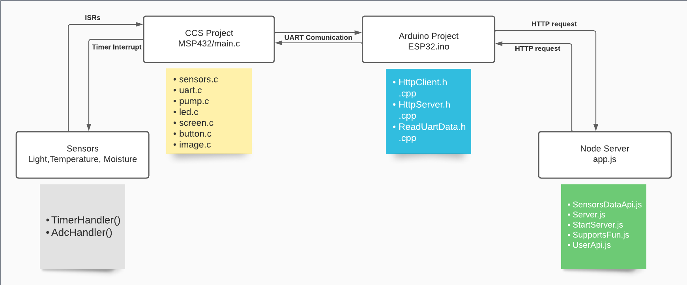
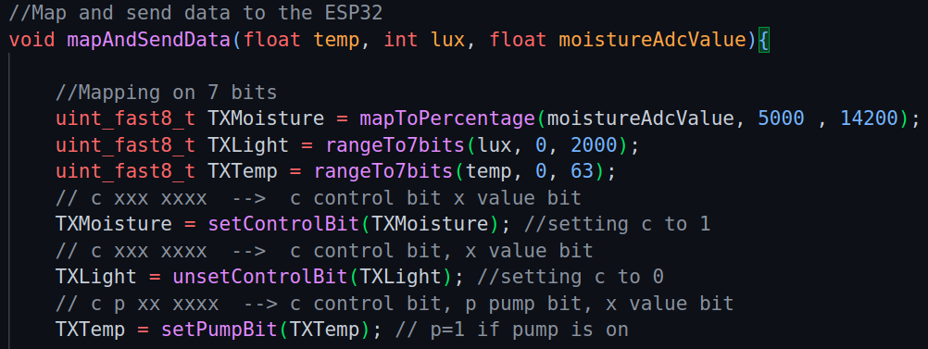
Software architecture

Slide 5

Problems, problems
Serial communication
Moisture mapping
Interactive menu display
Testing
Separate testing of the software components on host machine
Sensors mapping
Code integration of the different modules
Final testing on the target machine with all sensors connected

Slide 6
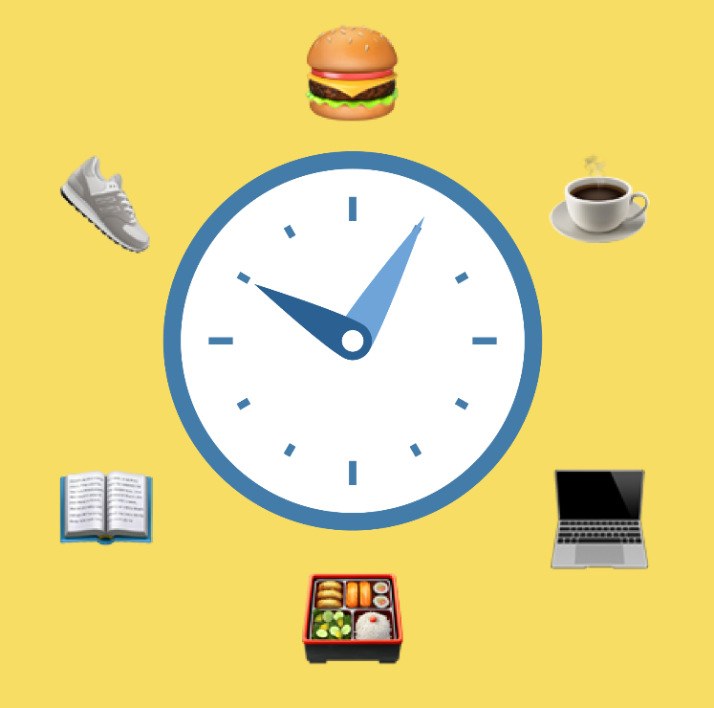
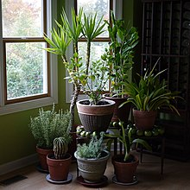
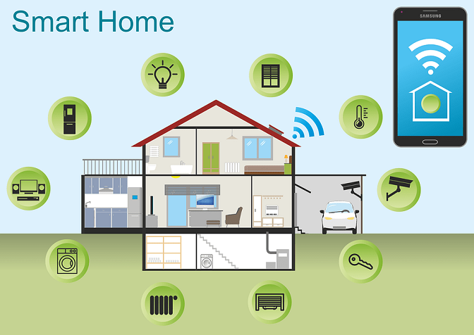
Conclusions and Future Work
Some custom routine for improve automatic irrigation
Adding plant information to improve system flexibility
Integration of the system in a larger and centralized Environment

